Slide 1
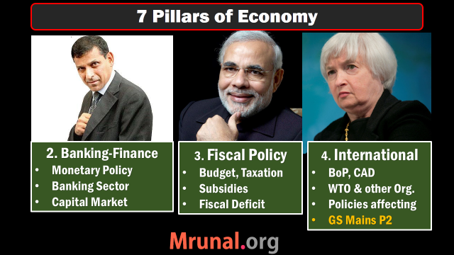
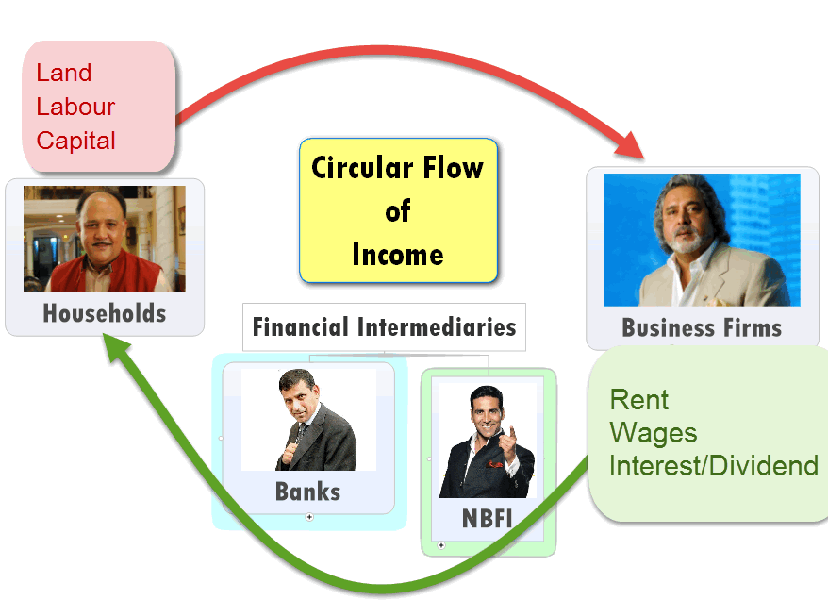

#1: NCERT

Slide 2

All clients can borrow short term loans from RBI @this interest rate. can’t use SLR securities though!
Have to set aside this much cash in reserve
=no income
Long term loan from RBI
Bank Rate 8.75
MSF
8.75
Repo 7.75
RR 6.75
SLR 21.5
CRR 4%
NDTL
Only for Sch. Commercial banks can borrow from RBI @this Interest rate. Can even use SLR securities
What RBI pays to its clients for short term loans
Banks have to keep this much in cash, gold, G-sec & other RBI approved securities

Slide 3
Monetary Policy
Quant. Tool | Inflation fight Tight/Dear | Deflation fight Easy/Cheap
CRR, SLR | Increase | Decrease
OMO | Sell | Buy
Policy RATE | Increase | Decrease

Slide 4
Bi-monthly | 2014 | Bank Rate | MSF +1 | Repo | RR -1 | SLR | CRR
first | April | 9 | 9 | 8 | 7 | 23 | 4
second | June | 9 | 9 | 8 | 7 | 22.5 | 4
third | August | 9 | 9 | 8 | 7 | 22 | 4
fourth | Sept,30 | 9 | 9 | 8 | 7 | 22 | 4
Fifth | Dec, 2 | 9 | 9 | 8 | 7 | 22 | 4
Surprise | 15/1/15 | 8.75 | 8.75 | 7.75 | 6.75 | 22 | 4
Sixth | 3-Feb-15 | 8.75 | 8.75 | 7.75 | 6.75 | 21.5 | 4

Slide 5

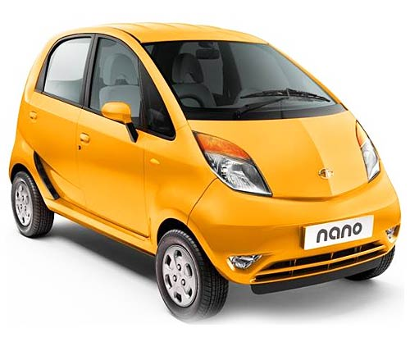

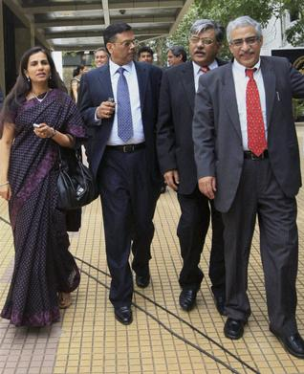

Qualitative Tools

Slide 6

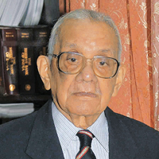


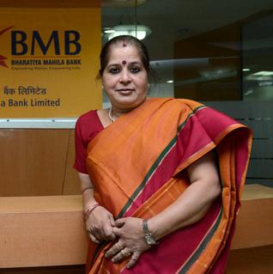

Evolution of Banking Sector

Slide 7
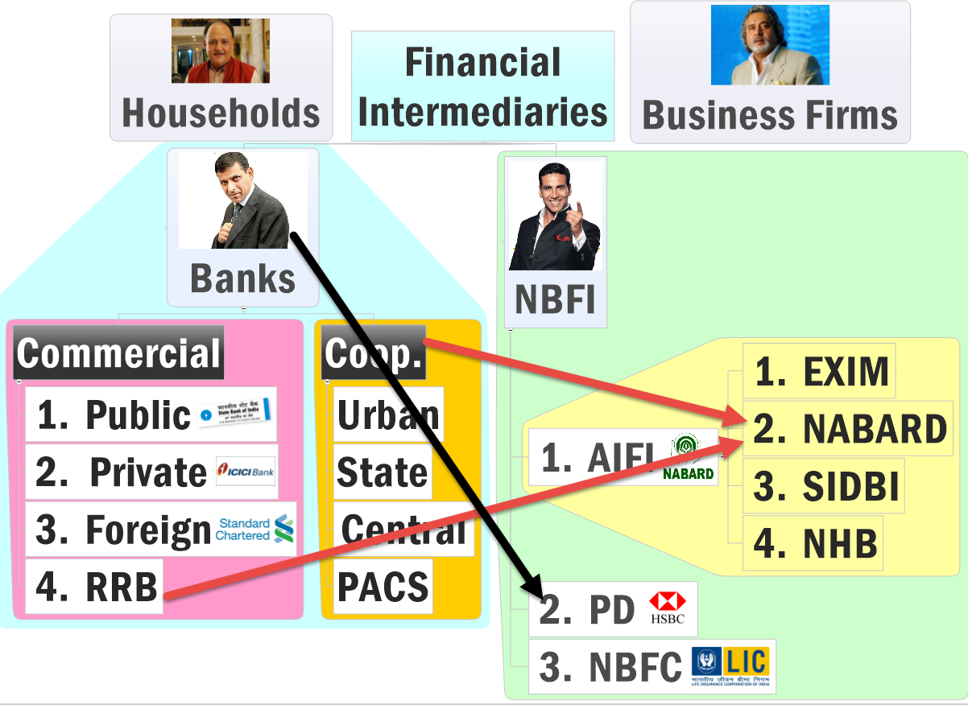

Slide 8
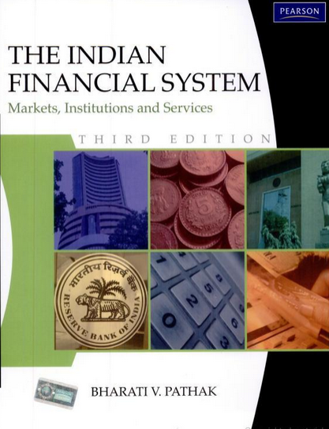
Financial Market
Debt vs Equity and their subtypes
G.Sec, T-Bill, P-Notes, ETF, Hedge funds……
If any discrepancy in these PPTs vs. wiki,Ramesh, Dutt-Sundaram et al that’s bcoz I refer to book for NBFC & Finance topics.
PS: You don’t need to buy or read this book. This is only for ‘disclaimer’.

Slide 9
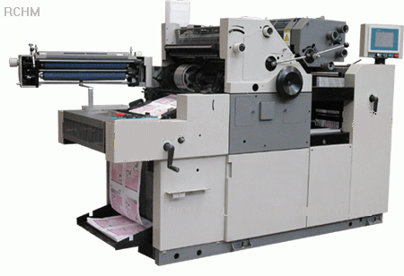


KVP: ~8 years
2x money
Rs.5 lakh
Rs.10 lakh
Inflation.. ??
Demand uncertainty?
Notes:
Tea seller vs fortune 500

Slide 10


Rs.5 lakh
Equity
Rs.10 lakh

Slide 11
Debt
Securities
Rs. 1000 @8%; 10 years
Fixed income; Irrespective of profit
Bonds, debentures, loan, ECB, T-Bill, Commercial Papers, Certificate of deposits. (REF: INVESTOPEDIA)
Creditor to company
First claim during liquidation
Notes:
Bonds r issued by a Government and thats the reason risk of default is very less. Other side, Debentures r issued by companies where the risk of default is very high.
Yield(rate of return) and the maturity always inversely related.
. In general terms bondholders are secured by access to the underlying asset in case of default by the issuer. Debentures, on the other hand, are unsecured, and debenture holders do not have recourse to assets in the case of default by the debenture issuer.

Slide 12


Rs.10 lakh
Equity: Shareholders
Proprietors
Creditors
20%
80%
5 lakh
1 lakh
4 lakh

Slide 13

Liquidation: 6 Lakh
Rs.1 Lakh
Creditors
20%
80%
20k
80k
5 lakh
Notes:
Interest rate?

Slide 14
UPSC 2003
Debenture holders of a company are its:
Shareholders
Directors
Debtors
Creditors
Right answer
1. Skip 2. Attempt 3. Mark n Review

Slide 15
Debt Instruments ऋण साधन | ऋण विलेख
Credit rating: Gilt securities vs Junk bonds
Bond vs Debenture
OFCD
Other types of Debentures
Inflation indexed bonds (IIB)
Creditors

Slide 16
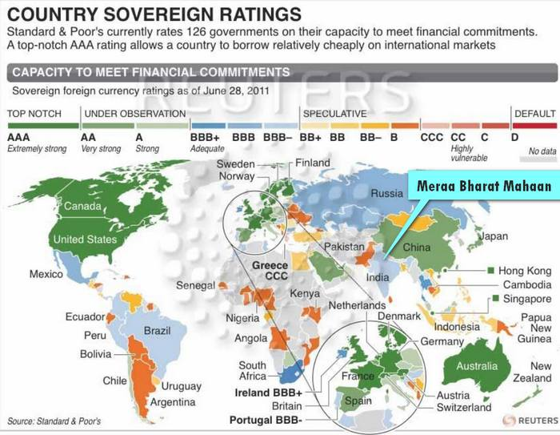
Credit Rating
Gilt Edged
Junk
SEBI >18 month
Notes:
CRISIL, CARE, ICRA, Moody’s Fitch, S&P
SEBI 18 months

Slide 17
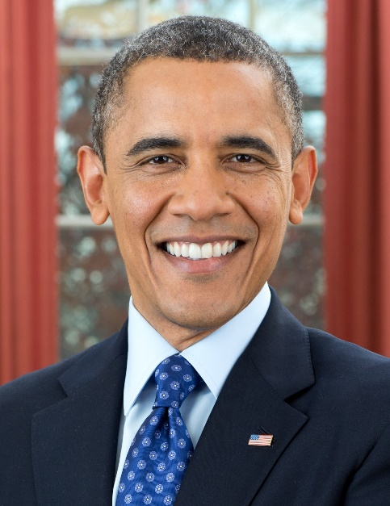

Gilt Edged
Junk Bonds
Assured return
Unlikely to default on payments
But low return e.g. US Treasury bond ~2%
Company may default
But higher return: ~15-17%

Slide 18
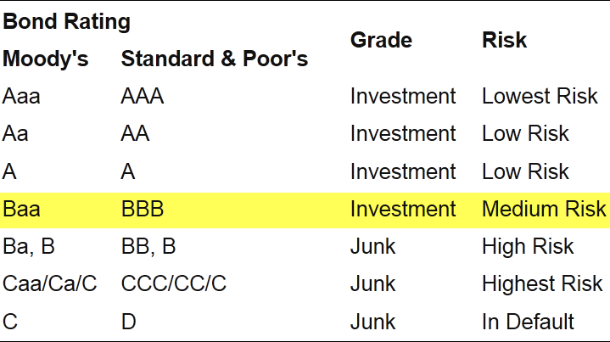
Credit rating for Sovereign Bonds
India BAA3
India BBB-

Slide 19
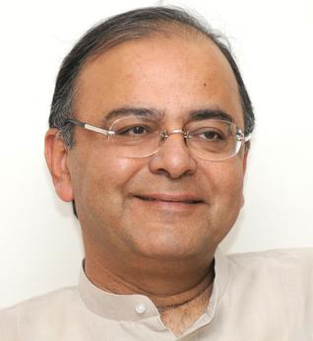
Factors affecting credit rating
India
Fiscal deficit
Inflation
Infrastructure
Foreign investment
GDP growth
Rating Improve expected in 2015

Slide 20
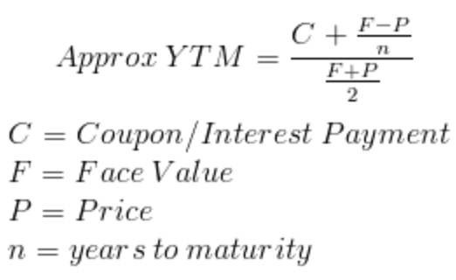
Bond Yield to maturity?
securities
Rs.100, @8%, 5 years
I keep it for a year (Rs.8 earned)
My yield: 8/100= 8%
Then I sell it @Rs.90
2nd buyer Current Yield: (8/90)= 8.89%
3rd buyer Current Yield: (8/80)= 10%
Yield to maturity (YTM)

Slide 21
Bond Yield?
Gilt Edged
Assured but Low return: US Treasury bond ~2%
Bogus Government => panic sales by investors=>Bond yield goes high
2/100=> 2%
(2/50)=>4% (higher yield)
Credit rating down: next time have to offer higher interest rate – Junk bond

Slide 22
REMEMBER for MCQs
Yield vs Bond Price (inverse relation)
Interest vs Bond Price (Inverse relation)

Slide 23
Bond Vs Debenture
Bond (Britain) = Debenture (America)
Bond (Govt./PSU) = Debenture (Private)
According to Stamp duty computation
Notes:
State guarantee, account practices

Slide 24
Debt instruments Types
Gilt edged securities vs Junk bonds
Bond vs Debenture
Municipal Bonds
OFCD
Other types

Slide 25

Municipal bonds
Debt
1997: Bangalore Muni. First to launch with state guarantee (Rs.125 cr)
1998: A’bad muni. First to launch without state guarantee (Rs.100 crore)
Permitted to raise Upto Rs.10k Crore, but hardly 1400Cr. Actually raised.
Need more funds for smart cities

Slide 26

SEBI guidelines 2015
Muni. Bonds
Muni. Must contribute 20% of the project cost
Bond tenure: minimum 3 years.
Muni. Must have good financial track record.
provident funds, pension funds and insurance companies can put in their money
Minimum 75% must be subscribe, else refund entire amount
Ignore for
Non-UPSC

Slide 27


OFCD
Optionally fully-convertible debentures (OFCD)
Debenture
Shares
Notes:
2 debenture to 1 equity and so on

Slide 28

OFCD
Debenture
Shares (Equity)
Company
Investor
Interest Payment…x
Only profit share
No profit= no dividend
Higher profit=> Bigger dividend

Slide 29
Debenture: other types
Non-Convertible
Partially convertible: Rs. 100 Debenture: Rs.70 + 30 (Equity)
Fully convertible: Rs. 100 Debenture=> equity (no choice)

Slide 30
Debenture: other types
Optionally: Choice after two years 1 Debenture = 3 shares
Redeemable vs irredeemable (b4 Maturity)
Fixed interest rate vs Index-linked

Slide 31
Inflation Indexed Bonds
Why?
Types and features
Notes:
Bond: convertible no?

Slide 32
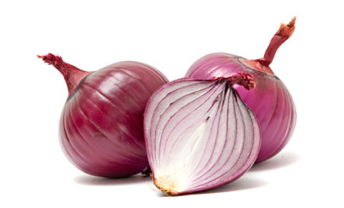
 | Rs./kg | Money | Buy?
1st Jan | 20 | 100 | 5 kg

Slide 33
 | Rs./kg | Money | Buy?
1st Jan | 20 | 100 | 5 kg
31st Dec | 100 | 104 | ~1 kg
Purchasing Power?

Slide 34
Interest Rate: Real Vs. Nominal
 | Nominal | CPI (Inflation) | Real =Nominal MINUS inflation
Savings account | 4% | 11% | -7%
Fixed Deposit | 9% | 11% | -2%

Slide 35
Investment in gold
Jan 2012: ~27,000
Jan 2013: ~31,000
Profit : (31-27)/27= 15%

Slide 36
Interest Rate: Real Vs. Nominal
 | Nominal | CPI (Inflation) | Real =Nominal MINUS inflation
Savings account | 4% | 11% | -7%
Fixed Deposit | 9% | 11% | -2%
Gold | 15% | 11% | +4%

Slide 37

Why Gold consumption bad?
Inflation
Saving => Capital…..x
Gold import ▲ = Trade deficit ▲
Current Account Deficit ▲
Rupee ▼
Crude oil ▲ = Petrol, Diesel ▲
Inflation ▲
Real Interest rate (negative)
More Gold consumption

Slide 38
How to stop this vicious cycle?
Gold import ban: Smuggling
Reduce Inflation: takes time
Provide new investment avenues with positive REAL interest rate.

Slide 39
Inflation indexed bonds
IIB
IINSS-C
Jun 2013 (Aug, Sep, Nov…)
Dec 2013
Inflation Indexed National Savings Securities-Cumulative (IINSS-C)

Slide 40

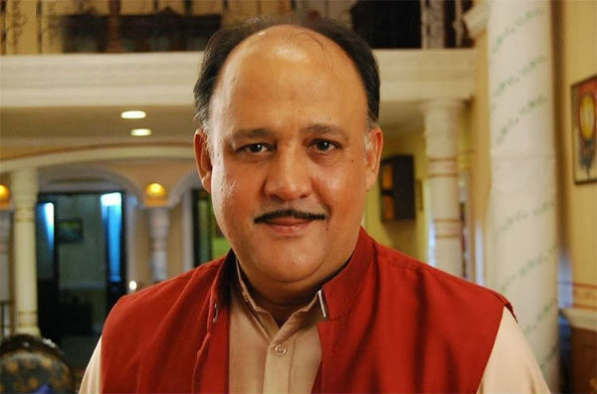
Inflation indexed bonds
IIB
IINSS-C
Institutional Investors (80%) + Retail (20%)
Only retail investors
Individual / NRI
HUF
Charity org
Educational bodies

Slide 41
Inflation indexed bonds
IIB (june)
IISS-C (Dec)
RBI direct sell
RBI =>
Nationalized banks
Axis
HDFC
ICICI

Slide 42
IIB (june)
IISS-C (Dec)
Min 10,000
Max 25 lakhs
Min 5000
Max
10 L (individual)
25 L (org)

Slide 43
Inflation indexed bonds
IIB (June)
IISS-C (Dec)
Matures @10 years
Redeem penalty
Same. But senior citizen =some relief.

Slide 44

WPI
4 Months prior
1st Jan
IIB
10,000
1.44+WPI
Compounded
half yearly
(June)
Real Interest Rate
+ve/-ve?

Slide 45
Interest Rate: Real Vs. Nominal
 | Nominal | WPI | Real =Nominal MINUS inflation
SA | 4% | 11% | -7%
FD | 9% | 11% | -2%
IIB | X +1.44 | X | +1.44

Slide 46
Inflation indexed bonds
IIB (june)
IISS-C (Dec)
1.44% + WPI (2004)
Four month lag
Compounded half yearly
1.5% + CPI (Combined) 2010 base year
3 months lag
Compounded half yearly

Slide 47
Inflation indexed bonds
IIB (june)
IISS-C (Dec)
Principal also protected
Rs. 10,000 (2013)=> 60%=>16,000 (2023)
Earlier Capital index Bond (CIB) 1997.
Same with CPI

Slide 48
Inflation indexed bonds
IIB (june)
IISS-C (Dec)
Can be traded @secondary market
Capital Gains Tax…yes
Nope

Slide 49
Financial Market
Money Market
Capital Market
Primary
Secondary
Short term
Long term
IIB

Slide 50
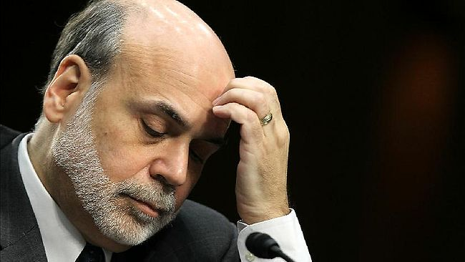
losing sheen (January 2015)
IIB
MF Invested heavily in IIBs during high inflation (2013-14)
Top 3 MF : ICICI Prudential, HDFC and SBI
But WPI to be ~2.5% in next few months
1.44+2.50=~4%
Hence players exiting the game.
IIB worth Rs.100 (FACE VALUE) sold @Rs.80

Slide 51
Debt vs Equity
Credit rating
Debenture types
Municipal bonds, inflation indexed bonds
NEXT: T-Bill and G-Sec

Slide 52
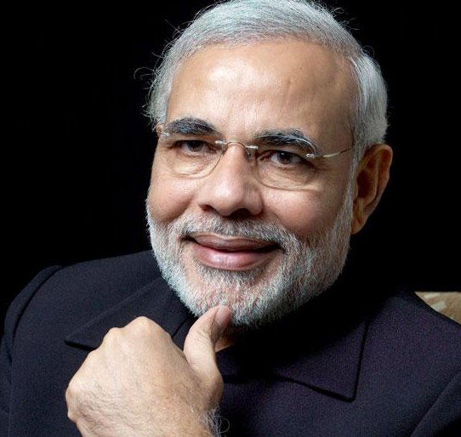
Financial Market
Money Market
Capital Market
Primary
Secondary
Short term
Long term
T-Bill
G-Sec

Slide 53


Government borrowing
T-Bill
G-Sec
Upto 364 days
14, 91, 182, 364 days
1 to 20-30 years
OMC, Fertilizer companies
Notes:
Profit: 25%

Slide 54
Return method differs
T-Bill (364 days)
G-Sec (1 or more year)
@discounted price
Rs.100 @Rs.80 (14 days)
1 to 20 years
Principle + Interest
Rs. 1000 @8% (20 years)
Notes:
Profit: 25%

Slide 55
Aptitude: mock question
A shopkeeper sells you a pen @20% discount and repurchases it after a week @MRP. What is your profit?
10% Profit
12.5% Profit
20% profit
25% profit

Slide 56
Aptitude
MRP: 100
Sold @20% discount: 100-20=80
Your investment = Rs.80
You sold back @100 (MRP)
Your profit= (100-80)/80 = 2/8=25%
Mental calculation: 100/80=1.25 hence 25% profit

Slide 57
Government borrowing
T-Bill
G-Sec
Upto 364 days
14, 91, 182, 364 days
@discounted price
Rs.100 @Rs.80 (14 days)
1 to 20 years
Principle + Interest
Rs. 1000 @8% (20 years)
If Bond @discounted price=> Zero Coupon Bond
Notes:
Profit: 25%
Bearer bond

Slide 58
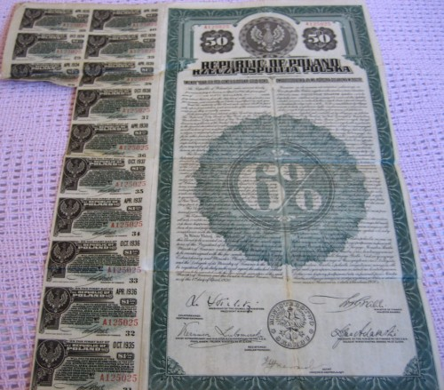
Coupon bond: $50, 6%, 20 years
20 coupons

Slide 59
Zero coupon bond?
Without coupons
But sold at a discounted price. (Rs.100 at 80)

Slide 60
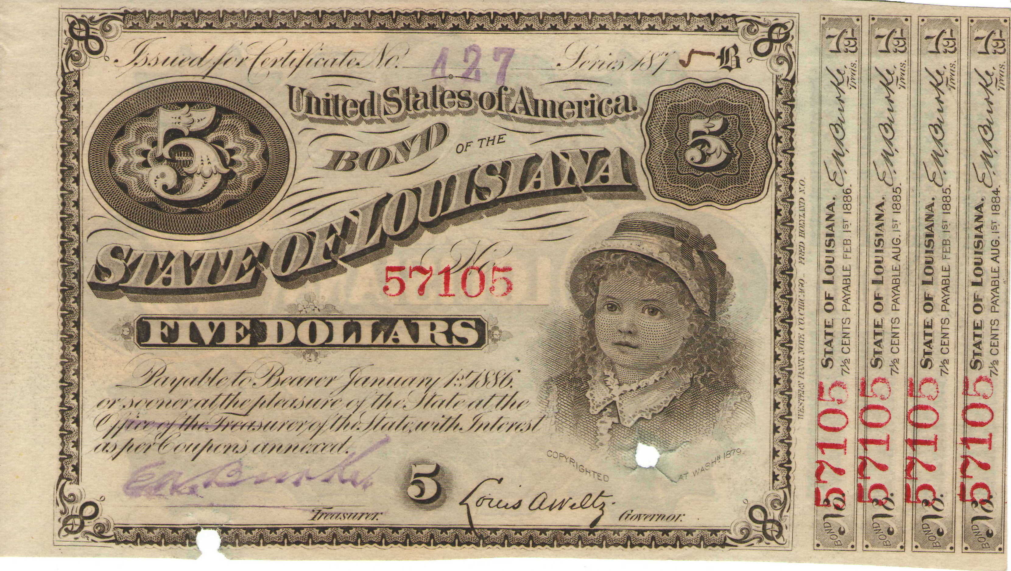
Bearer Bonds: no names, no records

Slide 61
Financial Market
Money Market
Capital Market
Primary
Secondary
Short term
Long term
T-Bill
G-Sec
Notes:
Yield to Maturity

Slide 62

Find correct statements
T-Bills are zero coupon securities
T-Bills don’t pay interest rate.
Both A and B
Neither A nor B

Slide 63
Money Market Misc. Terms
Ways and Means Advances
Comm.Papers
Certificate of Deposits
Commercial Bills
Call money, Notice money
Chronology, Factoids
Exact Mechnism
Only Basic idea

Slide 64

WMA
Money Market
Ways and Means advances
Government- temporary mismatch in receipt and payment
RBI helps. But limits fixed.
Not counted in fiscal deficit

Slide 65
Misc. Debt Instruments
Money Market
T-Bill: upto 364 days maturity, sold @discounted price (Govt.)
Commercial Papers: same thing but by Corporates.
Certificate of deposits: same thing by Banks & Fin. Institutes

Slide 66


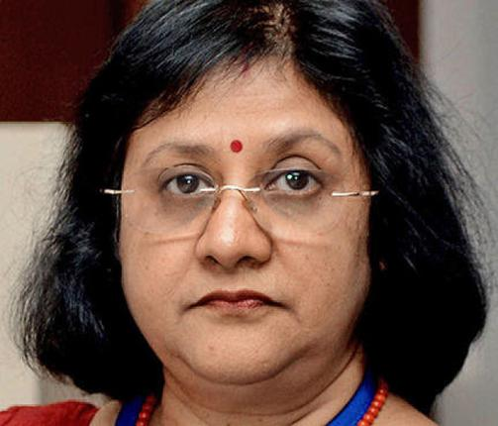
Money Market: Misc. Debt Instruments
Commercial Bills: Trade bill (will pay for xyz goods in future). Same trade bill sold to Commercial bank @discounted price = Commercial bills.
10,000
9,000

Slide 67
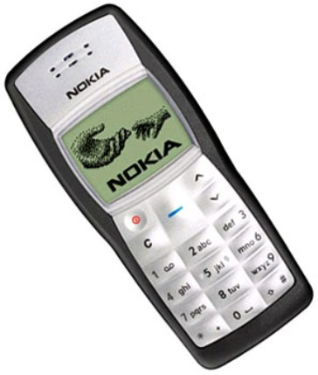
Call money
Money Market
Short term borrowing among banks and FI.
No collateral. Mainly to fulfill CRR
1 day: call money
Over 1 day upto 14 days: notice money

Slide 68
Credit rating
Gilt edged securities vs Junk Bonds
OFCD, Debenture types
Muni. Bonds, IIB
G-sec vs T-Bill
0-Coupen Bonds
Bearer-Bonds
YTM
Money market: Misc. Terms

Slide 69
Equities
IPO, Public issue, Red Herring
Book building
Bonus Issue, Rights issue, Preferential shares
ETF, MF, Hedge fund, P-Notes

Slide 70
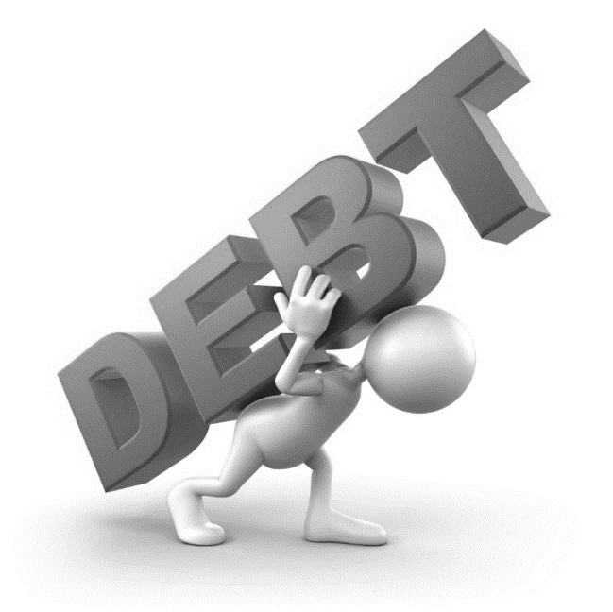
Shareholders
Proprietors
Rs.10 lakh
Creditors
20%
80%
1 lakh
4 lakh
5 lakh

Slide 71

Equities
Securities
*** % of shares out of 100%
Dividend from profit
IPO, Shares, VCF, Angel Investor
Owners / proprietors
Last claim during liquidation

Slide 72
Securities: Debt vs Equity
Debt (Debenture)
Equity (Shares)
Interest:
TAX @investor
Dividend:
Tax @Company
Notes:
Bonds r issued by a Government and thats the reason risk of default is very less. Other side, Debentures r issued by companies where the risk of default is very high.
Yield(rate of return) and the maturity always inversely related.
. In general terms bondholders are secured by access to the underlying asset in case of default by the issuer. Debentures, on the other hand, are unsecured, and debenture holders do not have recourse to assets in the case of default by the debenture issuer.

Slide 73

Economic activity
Debt =Interest
Equity = Dividend
Slowdown
Boom
Notes:
Choice of words
What is securities?
FII activities

Slide 74
IPO
Par value and Premium Value?
Red Herring
Public Issue
Book building

Slide 75
Shares Value: Par vs Premium
Par Value
Premium Value
Face value
Rs. 10, 100
(1999) Any integer
1,2,5,8,10,20,50,100
1.50……x
IPO < PAR VALUE ….x
@Rs.40
Face value + premium
Rs. 10 + 30 = 40
Notes:
Rs. 1 but not Rs.100

Slide 76
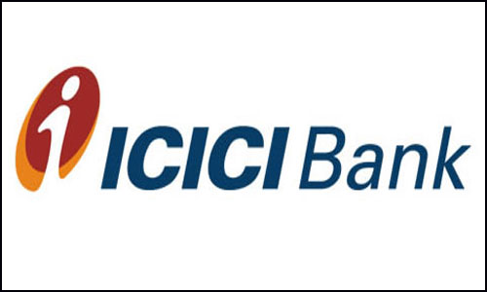



Underwriter
Promoter
Public issue
Underwriter
US: Investment banker
UK: Merchant Banker
Notes:
Red Herring: Offer price & date not given
US: Investment banker
UK: Merchant Banker

Slide 77
Fixed pricing
IPO
Initial Public offer
1 lakh equity shares
Par value Rs.10
Premium Rs.15
Final Price: (10+15)=25
IPO Total value: 25 lakh

Slide 78
#2: Book Building
IPO
Applications for 1 lakh shares
Rs. 500 x 10,000 shares
Rs. 200 x 50,000 shares
….
Rs. 125 x 40,000 shares
Rs. 100 x 5000 shares
125 cutoff [Because 1 lakh shares booked]
Notes:
Base price can’t be less than x

Slide 79

Features
E-IPO
Present: investor has to fill long paper form, cheque-clearance (T+12)
Proposed: electronic application via internet, share-broker’s terminals, even mobile apps.
If IPO allotted, investor gets email-SMS alert.
Notes:
T+12
Stock brokers will have to use the National Automated Clearing House (NACH) implemented by the National Payments Corporation of India (NPCI) to receive upfront payment from the investor

Slide 80
Benefits?
E-IPO
Time reduced to (T+2 or T+3)
Companies get equity-funding @cheaper + @Faster speed.
Retail participation ▲
In future even Debt-instruments too. (But need amendment in SEBI regulation)

Slide 81
Retained earning
Revenue
- interest to Debenture/bonds/loans/ECB
- salary, Expenditure, input cost
- Taxes [corporate, excise, service]
- dividend to preferential shares
- dividend to ordinary shareholders
====
Reserve / Company’s Retained Earnings

Slide 82
What to do with Retained earning?
Share buyback (1998)
Invest in other companies, open new subsidiaries
Issue bigger dividend next time

Slide 83

Bonus Shares
Equities
Issue bonus shares (FREE)
1:2 =one bonus share for two existing shares

Slide 84
Rights Issue
Equities
Bonus issue….FREE
Rights issue….NOT FREE
Existing shareholders given first right to purchase new shares
According to their existing shareholding
If they refuse => offer to aam junta.
NOT IPO

Slide 85
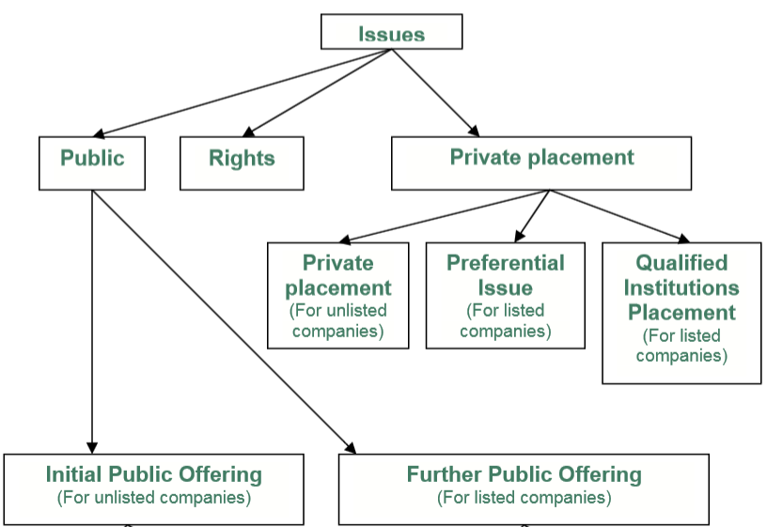

Slide 86
FPO, Rights issue
Fast track
IPO= first time share sold & company gets listed on stock exchange
FPO= [Follow on Public Offer] when same company issues more shares OR disinvestment
SEBI: for PSUs & companies with 250 crores valuation= they can do FPO without SEBI clearance.

Slide 87
Preferential shares
Bond/Debenture: first payout, first claim
Ordinary share: Last payout, last claim
Debenture> Preferential share > ordinary shares
Voting …or Non voting (FDI limits, Bank license limit)

Slide 88
Share splitting (SBI)
Before
After
1 share x Rs.10 face value
10 shares x Rs.1 face value

Slide 89
Why share splitting?
Liquidity to investor (Easier to sell Rs.1 share than Rs.10 share)
Increases retail participation
Doesn’t increase company’s market capitalization
Doesn’t increase company’s value

Slide 90
Bonds
Equities
IPO, book building, E-IPO
Bonus shares
Rights issue
Preferential shares
NEXT:
ADR, GDR, Bharat DR, IDR

Slide 91


Shares
ADR
Dividend
$$
NASDAQ

Slide 92
ADR GDR
DR : Depository receipt
Kingfisher=> NASDAQ (SEC permission, accounting norms)
Kingfisher => Indian shares @Bank of America (investment banker)
BoA => Kingfisher ADR=> NASDAQ
10 desi shares = 1 ADR [$ paid, $ dividend]

Slide 93
ADR GDR
GDR= Global depository receipts @EU
1st GDR: Reliance '92
1st ADR: Infosys '99

Slide 94
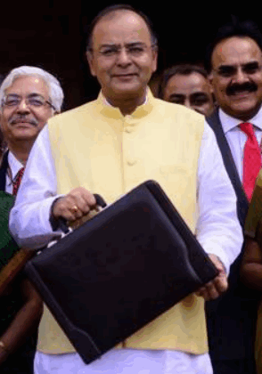
Budget 2014 reform
Reduce restrictions on ADR GDR
We’ll introduce Bharat Depository receipts

Slide 95
Shares
IDR
Bh.DR
Dividend
Indian Stock Exchange

Slide 96
IDR, Bharat Depository receipts
2004: IDR permitted
So far only 1, via Standard chartered
Finmin: MS Sahoo panel
Bharat Depository receipt (BhDR)
Both debt and equity
IDR will be a subpart
Notes:
MS Sahoo, secretary, Institute of Company Secretaries

Slide 97
IDR, Bharat Depository receipts
Only SEBI regulation
Level I : sophisticated investors
Level II: all investors
Allow Foreign investors
More choices for Indian investors (Gold CAD)
Notes:
MS Sahoo, secretary, Institute of Company Secretaries

Slide 98
Bonds, Equities
IPO, Bonus shares
ADR, GDR, IDR,Bh.DR
NEXT
Mutual funds, ETF
Hedge funds, P-notes

Slide 99



Mutual fund
NAV
Unit
Unit
Unit
EXIT LOAD
Portfolio (AMC)
Notes:
NAV fluctuates daily.
Definition: Mutual funds companies collect an amount from investors when they join or leave a scheme. This fee charged is generally referred to as a 'load'. Exit load is a fee or an amount charged from an investor for exiting or leaving a scheme or the company as an investor. Description: The aim behind the collection of this commission at the time investors exit the scheme is to discourage them from doing so, i.e. to reduce the number of withdrawals by the investors from the schemes of mutual funds. Different mutual funds houses charge different fees as an exit load.

Slide 100
Mutual funds types:
Portfolio Nature: equity, debt, gilt edged fund, real estate
Income vs risk
Growth Fund: 80 (Equity): 20 (Debt)
Balance: 50: 50
Income = 20 : 80

Slide 101
ETF: Exchange Traded Fund
ONGC, CIL, GAIL
10 CPSE
Rs.3000 crore
NFO
Rs.10
Rs.10
Rs.20
Rs.10
Portfolio Goldman Sach
BSE-NSE
Notes:
NAV fluctuates daily

Slide 102
ETF different from MF?
15 ETF: 1 free (for high quantity orders)
Redeem
MF Unit: CASH (minus EXIT LOAD)
ETF: Shares=> secondary market sell=>CASH
EXIT load…no; commission less
ETF: USA 1993; India 2002
Modi: March 2015, 5k-ETF planned

Slide 103



Hedge Fund = pvt MF for HNI
Unit
Unit
Portfolio (Hedge Fund)
Unit
Notes:
NAV fluctuates daily

Slide 104
Hedge Fund
HNI=> private MF
SEBI: min. 1 crore investment (SBIMF-100)
Karvy Capital, Motilal Oswald etc.
SEBI regulation…not strict like MF
Alternative investment fund Cat.III
High risk, high reward
100 Cr. Pooled=> bet upto Rs.200 crore (T+2)

Slide 105


P-Notes: Participatory Notes
Hedge Fund manager
Notes:
PAN, registration,

Slide 106

P-Note: Offshore Derivative Instrument
Hedge Fund manager
FII
(India)

Slide 107


P-Note: Offshore Derivative Instrument
Offshore Investor
Without PAN card, DEMAD account
or SEBI Registration
Shares
bonds
SEBI registered
FII (India)
Tom can sell
P-note to others without paying capital gains tax
to India
P-Note
Derives value from
FII portfolio
FII’s portfolio

Slide 108
P-notes : SEBI
March 2014: 2 lakh Crore (13% of FII)
Hot money
CGT evade
Anonymous (Quarterly records to SEBI)
terrorist money (Ex-NSA MK Narayan)
Money Laundering (FM Whitepaper)

Slide 109




Hawala operator sends Rupees to Tax Haven, converting
to Dollars
Sadhu Yadav a.k.a Politician, builder, Contractor & Mafia
all in one Multiskill
Hedge Fund Manager or Investment banker
in Tax Haven
SEBI registered FII
P-Note
Derives value from FII’s portfolio
FII’s portfolio

Slide 110
SEBI on P-Notes
FPI new classification
Risk profile + KYC compliance
CAT I: Foreign government, government's fin. Institutions (UTI, EPFO, LIC)
CAT II: Mutual Fund, Pension Fund, Univ.Fund,
CAT III: not in CAT I and CAT II (e.g. Hedge Funds)
Who can't issue P-notes?
CAT III
CAT II: certain high risk

Slide 111
Bond types, IIB, T-bill, G-Sec
Equities: IPO, share types
ADR-GDR, Bh.DR, IDR
MF, ETF, Hedge Fund, P-Notes

Slide 112
Derivatives, Options
Derivatives?
Forward vs future
CALL vs PUT?
Credit default swap

Slide 113
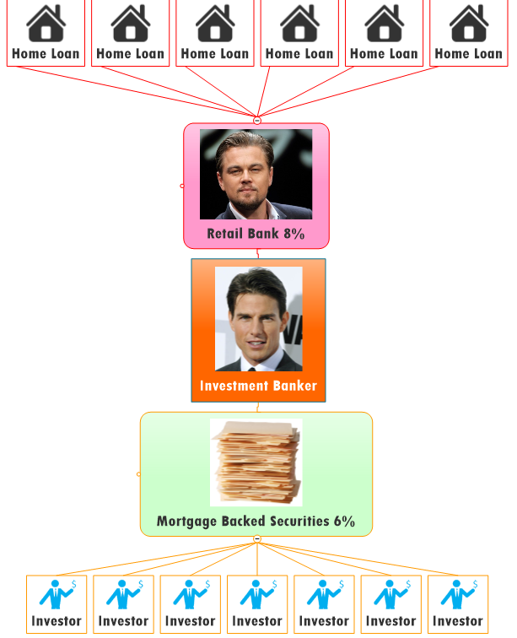
Mortgage backed securities

Slide 114
Financial instruments: 3 types of
Debt (Bonds, Debentures)
Equity (Shares)
Derivatives (derive value from assets)
Physical Assets (home, shop, machines)
Debt / equity
Forex
Commodity
Even other derivatives

Slide 115
Derivatives=> Futures/Forward
Sell / purchase /execution @future date
Future vs forward=> not important for UPSC.
Option: to minimize risk
Notes:
FMC: commodity option nope
Future: standardized (Currency futures)
Forward: tailor made (commodity market)

Slide 116
Option: CALL option
Right to buy
But no obligation to buy

Slide 117


CALL OPTION
3,04,000
Call writer
Premium 4k
Strike price:
Rs.150
(3 month)
2000 shares

Slide 118
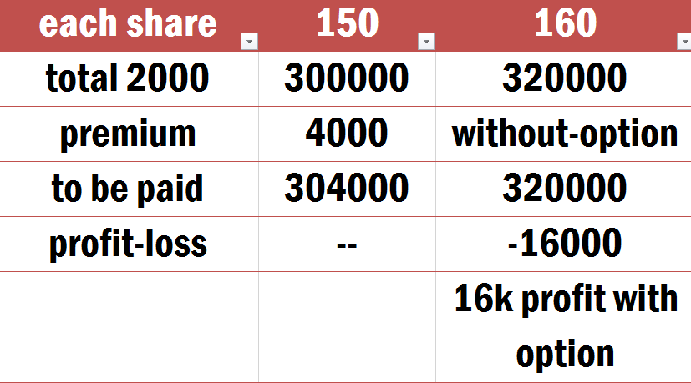
CALL option: right to buy
PROFIT
3.20
3.04
=16k
3,20,000
3,04,000
4,000
3 lakh

Slide 119
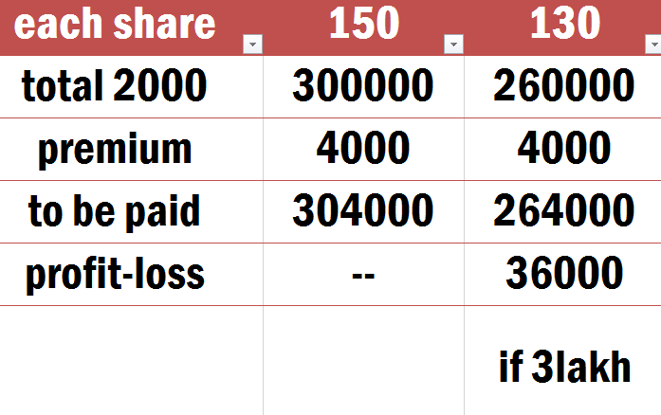
CALL option: No obligation to buy
Loss prevented
2.6 lakh
2,60,000
2,64,000
4,000
3 lakh

Slide 120

Option: PUT option
Right to SELL
But no obligation to SELL
Strike price: Infosys @Rs.150 x 2000 after 3 months.
Premium: Rs.4,000
140 …yes
160..refuse
Notes:
Specific price, specific date

Slide 121



How to memorize?
PUT option:
Right to sell
But no obligation to sell

Slide 122

Credit Default Swap (CDS)
BONDS
CDS

Slide 123

Credit Default Swap (CDS)
BONDS
Bond
Money

Slide 124
SENSEX calculation
Harshad Mehta, Ketan Parekh
Sahara, NSEL, Chit fund
FSLRC
Companies Act, Corporate governance
Vodafone, Nokia, GAAR, DTAA

